Slide 1
Project 1: AdaLoss Implementation for Multi-Class Classification
MSDA-3100-01 Applied Deep Learning
Clark University | Spring 2024

Slide 2
Introduction
Loss functions play a critical role in training deep learning models.
Traditional margin-based loss functions (e.g., ArcFace) use fixed margins, but they do not adapt based on input quality.
AdaFace introduces an adaptive margin that adjusts dynamically using feature norms, improving classification performance.

Slide 3
Problem Statement
ArcFace and similar losses apply a fixed margin to all samples.
Real-world data varies in quality—some images are more recognizable than others.
Hard samples should be emphasized only if they contain meaningful identity information.
AdaFace solves this by adapting the margin based on feature norms.

Slide 4
AdaFace Overview
Uses feature norm as a proxy for image quality.
Assigns different importance to training samples based on quality.
High-quality images → Focus on hard samples.
Low-quality images → Avoid overfitting on noisy data.
Improves performance on both high- and low-quality datasets.

Slide 5
Mathematical Formulation
Feature norm-based quality indicator:
ẑᵢ = (||zᵢ|| - μ_z) / (σ_z / h)
Adaptive margin functions:
g_angle = -m * ẑᵢ
g_add = m * ẑᵢ + m
Final loss modification:
f(θ_j, m) = s cos(θ_j + g_angle) - g_add (if j=yᵢ)

Slide 6
Implementation in PyTorch
Built as a PyTorch loss function extending nn.Module.
Uses batch statistics to normalize feature norms.
Dynamically modifies margin during training.
Code snippet is included in the report.

Slide 7
Experiments: Datasets & Model
Datasets: MNIST (digits) and CIFAR-10 (images).
CNN model with:
- Convolutional layers (ReLU, MaxPooling)
- Fully connected layers
- Batch normalization & dropout
Trained using AdaLoss and compared against ArcLoss.

Slide 8
Results: Accuracy & Loss Graphs
AdaLoss achieves higher accuracy on both datasets.
More stable loss convergence compared to ArcLoss.
Screenshots and graphs are included in the report.

Slide 9
Results Comparison
AdaLoss consistently outperforms ArcLoss, especially for CIFAR-10.
Model | MNIST | CIFAR-10
ArcLoss | 97.86% | 62.35%
AdaLoss | 99.11% | 68.13%

Slide 10
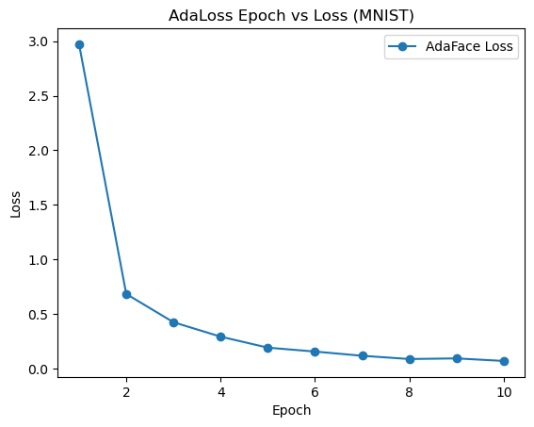
AdaLoss MNIST

Slide 11
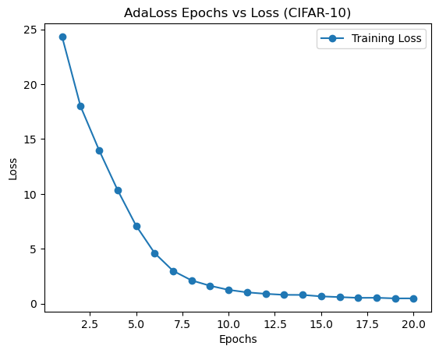
AdaLoss CIFAR-10

Slide 12
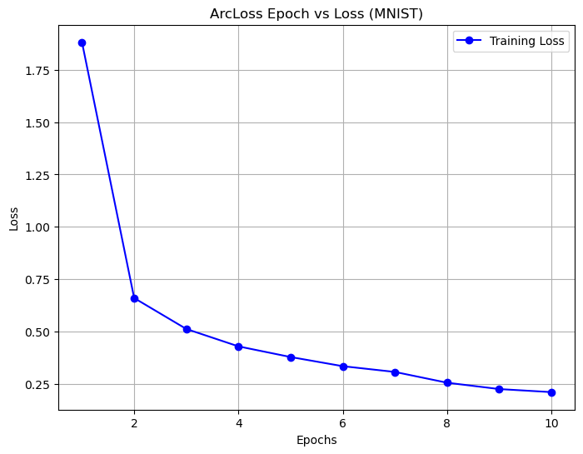
ArcLoss MNIST

Slide 13
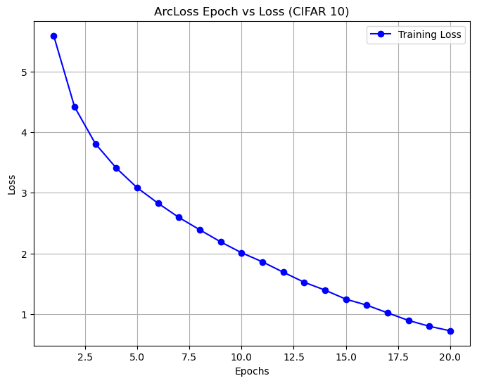
ArcLoss CIFAR-10

Slide 14
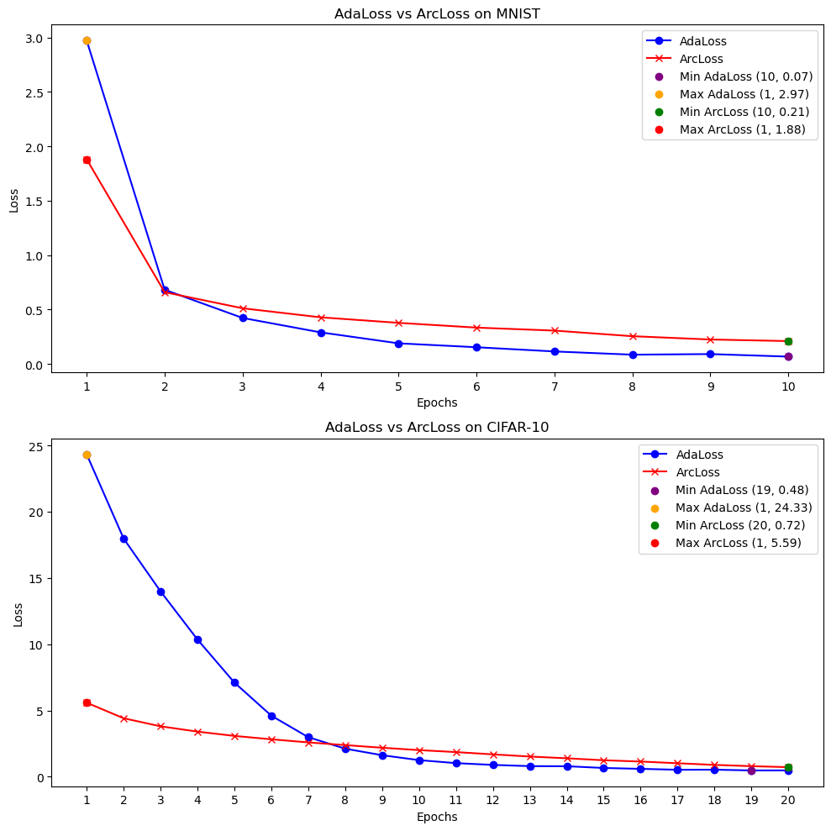
ArcLoss vs AdaLoss

Slide 15
Conclusion
AdaLoss adapts to image quality, unlike fixed-margin loss functions.
Improves classification performance, particularly for complex datasets.
Future work:
- Extend to larger datasets (ImageNet).
- Test on different neural network architectures.
- Explore hybrid loss functions combining AdaLoss with contrastive learning.

Slide 16
References
Kim, M., Jain, A. K., & Liu, X. (2022). 'AdaFace: Quality Adaptive Margin for Face Recognition'.
CVPR 2022, DOI: 10.1109/CVPR52688.2022.01819

